Slide 1

TOUR &
TRAVEL
Talk to us

Slide 2

Department of Computer Applications,
KIET Group of Institutions,
Delhi-NCR, Ghaziabad

Slide 3
Team Members
Aashish Panwar
Ashutosh Kakran
Vikas Sharma
Project Supervisor – Dr. Shashank Bhardwaj

Slide 4
ABSTRACT
Most of the people in this world like to travel from one place to another no matter whether it is a small or large distance. The need for a tourism management system that can manage tourism information with ease is sought after by every tour management company. Tour Management system is a dynamic website for tourism business.

Slide 5
TABLE OF CONTENTS
Intoduction
Technology used
Software Requirements
Hardware Requirements
Modules
Benefits
Scope
Reports
Conclusion
Gantt Chart

Slide 6

INTRODUCTION
Tour and Travel management system is used to book a tour from anywhere in the world by a single dynamic website which will help the user to know all about the places and tour details in a single website. The admin can add packages to the website from a certain travel agents and hotels by create a tour page. Then the users can sign in and book each project, they can be confirmed by the admin in their manage booking page.

Slide 7
TECHNOLOGIES USED
HTML : Page layout has been designed in HTML
CSS : CSS has been used for all desigining part
JavaScript: All the validation task and animations has been developed by JavaScript
MySQL : MySQL database has been used as database
PHP : All the business logic has been implemented in PHP

Slide 8
SOFTWARE REQUIREMENTS
Operating System : Windows XP, Windows Vista,
Windows 7 & above,
Linux, Mac
Code Editor : Visual Studio Code

Slide 9
HARDWARE REQUIREMENTS
Processor : intel i3 5th generation or Higher
Installed memory (RAM) : 4 GB RAM or More
Hard disk Requirement : 160 GB

Slide 10
MODULES
Home Page
Admin login
User login
Booking details
Package details
Feedback form

Slide 11
REPORTS
The purpose is to build a system that performs all operations related to traveling, booking, etc. This system connects customers and agents directly, provides a feedback mechanism for tourists, maintains and controls the database of tourists' information, and gives a variety of travel services.

Slide 12
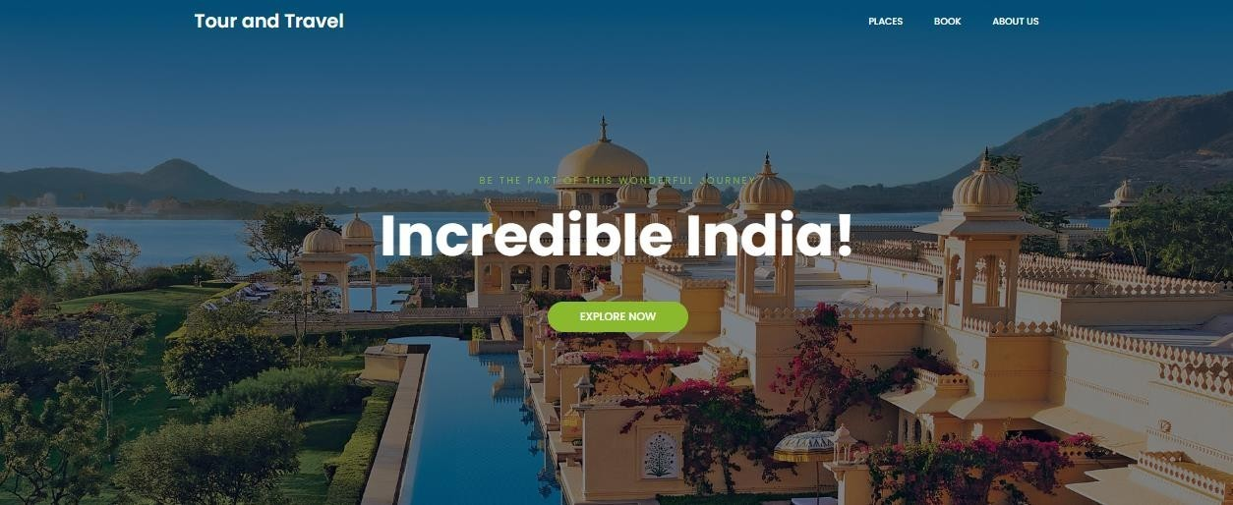
SNAPSHOTS
HOME PAGE

Slide 13
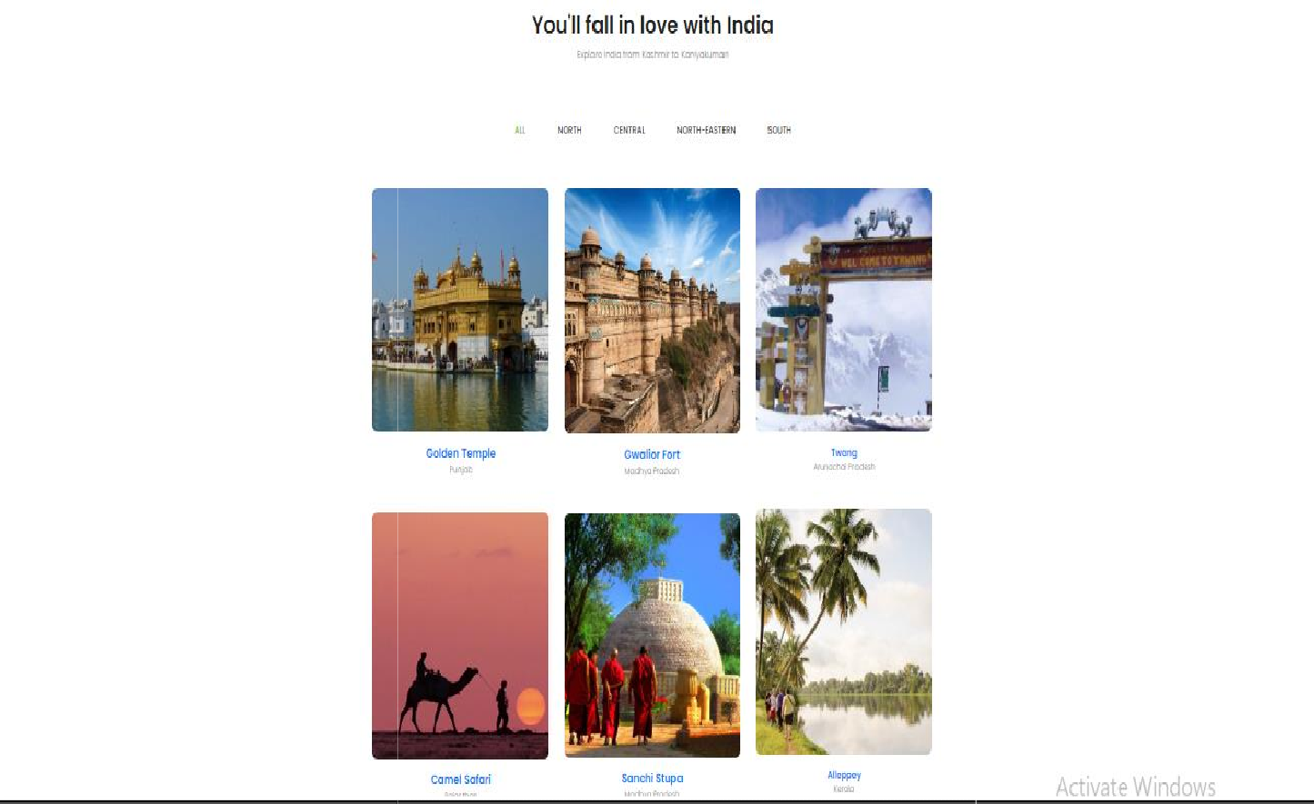
PLACES PAGE

Slide 14
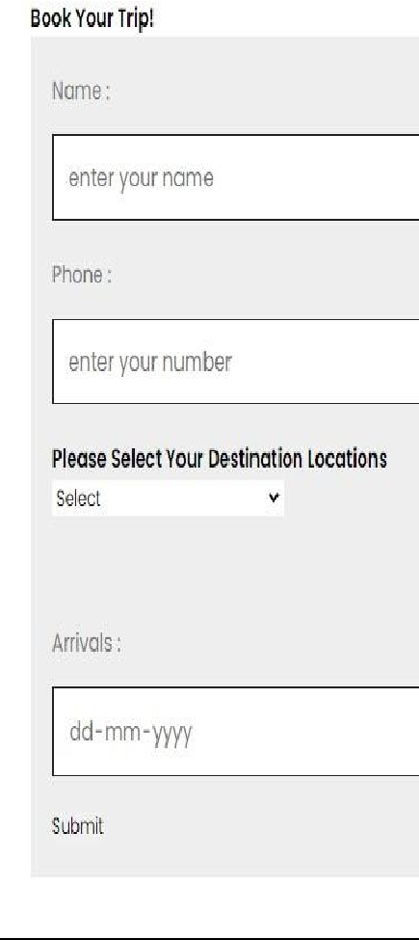
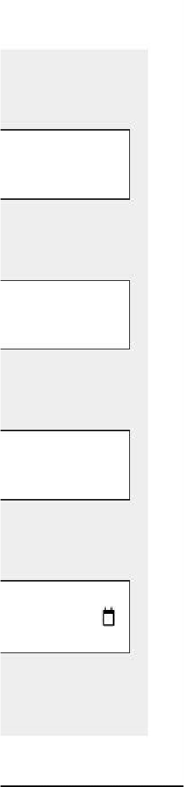
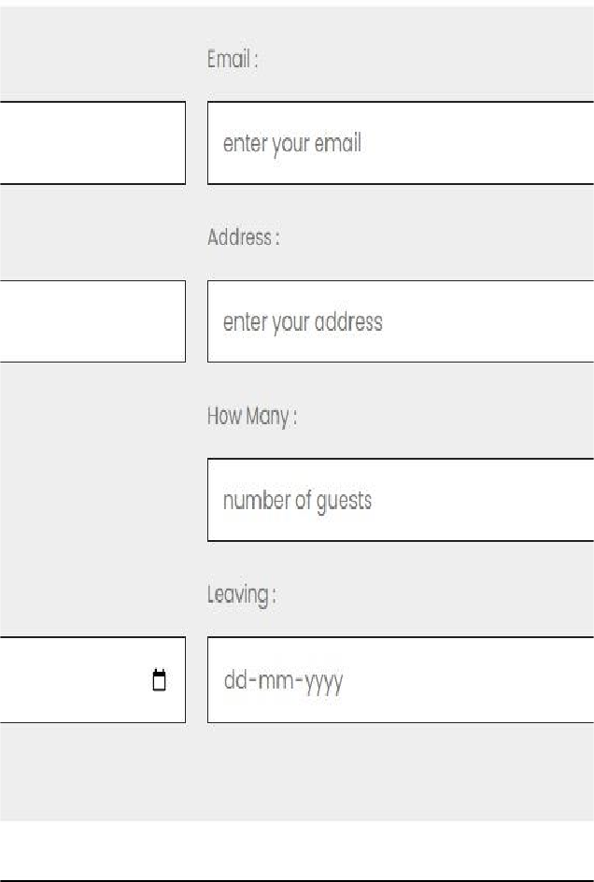
BOOK PAGE

Slide 15
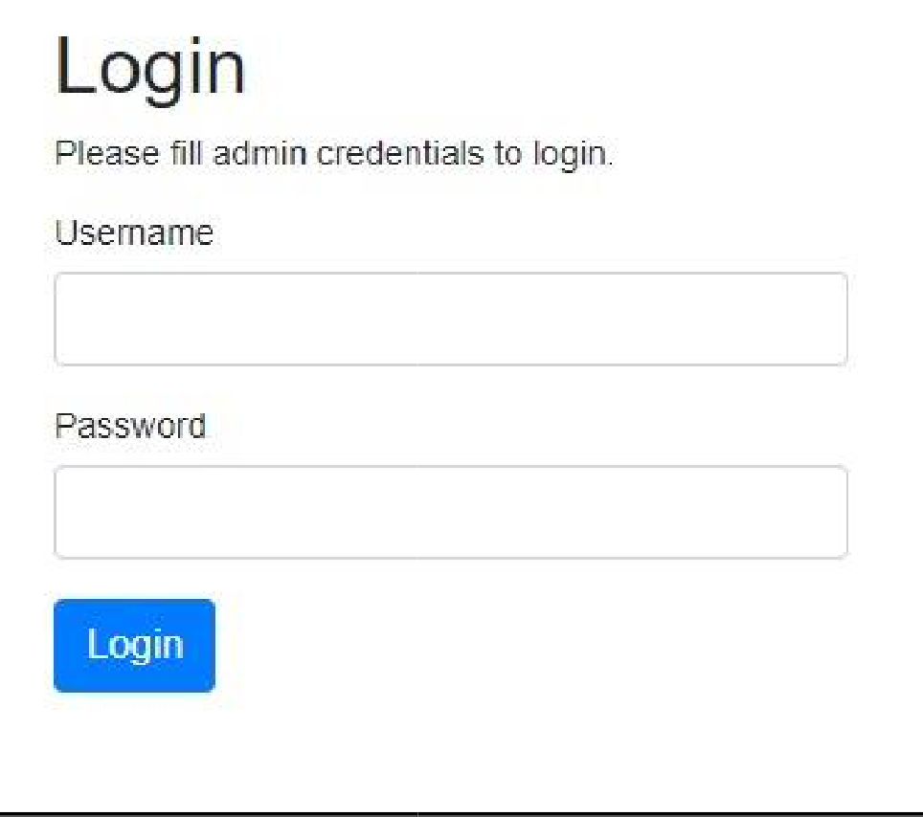
ADMIN LOGIN

Slide 16
CONCLUSION
This web application was successfully created and stored all the travel admin tourism packages booking, creation managing and tour details into the database using this application. The application was tested very well and the errors were properly debugged. Testing also concluded that the performance of the system is satisfactory. All the necessary output is generated. This system thus provides an easy way to automate all the functionalities of consumption.

Slide 17
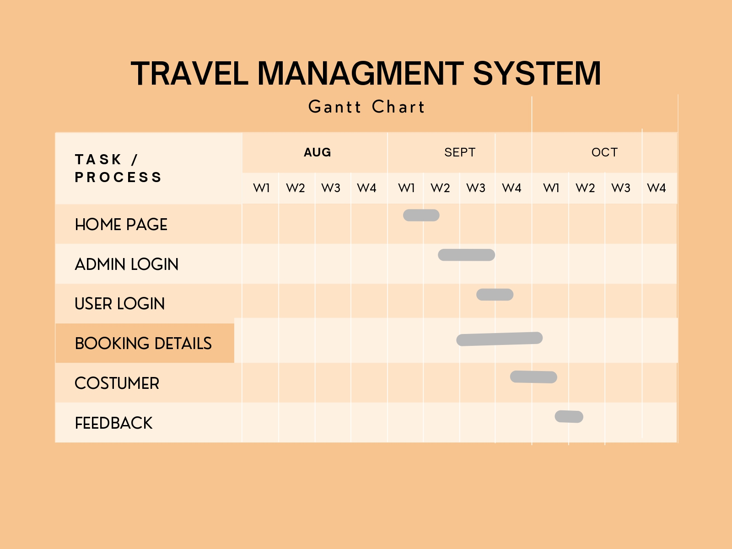

Slide 18

“WE WANT TO MAKE YOU FEEL AGAIN” THANK YOU !

